Slide 1



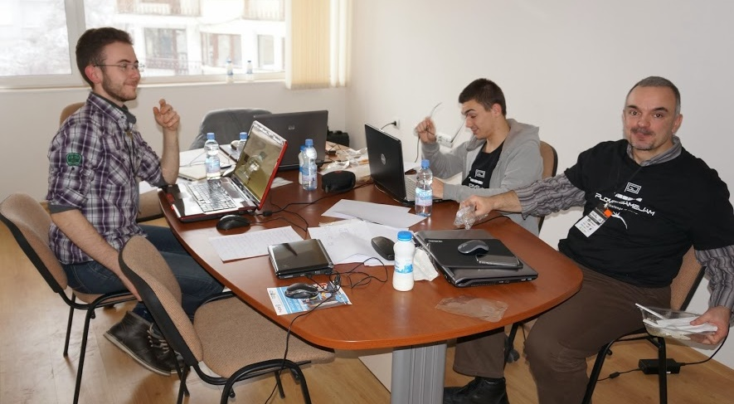
Team Work and Personal Skills
Course Introduction
Svetlin Nakov
Technical Trainer
www.nakov.com
Software University
http://softuni.bg

Slide 2



Table of Contents
The Open Sharing and Collaboration Culture
Course Objectives
Course Program
Trainers Team
Assessment
Learning Resources

Slide 3



The Culture of Knowledge Sharing and Collaboration
Open Education, Knowledge Sharing, Team Working, Helping Others

Slide 4

Open Knowledge and Education
What is "open knowledge sharing"?
A modern concept in education and society
Knowledge becomes open to the world
High-quality training becomes free
Idea broadly supported by:
World's top universities like Harvard, MIT, Berkeley, Stanford, Oxford, Cambridge, …
Online free training MOOC sites:
Khan Academy, Coursera, Udacity, edX, Ucha.se, Codecademy, Code.org, Code School, Telerik Academy, SoftUni, …

Slide 5
The World Becomes Open!
Open Education
http://en.wikipedia.org/wiki/Open_education
Citizen Science (Open Science)
http://en.wikipedia.org/wiki/Citizen_science
Open Knowledge Foundation
http://okfn.org
Open Knowledge Conference
http://okcon.org
Open Government
http://www.opengovpartnership.org

Slide 6
The Culture of Helping Others
“if one lights a fire for others, one will brighten one’s own way” ~Buddha
How it works?
Initially you get help from the others
E.g. from the Software University
You start a good job, have a good life standard, good incomes, etc.
Give back 10% of what you have to help others
E.g. help by volunteer work, by charity or by sharing your knowledge and skills

Slide 7



Course Objectives & Program
What Topics Shall We Cover?

Slide 8

The Course Objectives
Team Working and Personal Skills course goals
Develop a culture of open sharing of knowledge
Learn to enjoy collaborating with others
Learn to work in a team
Real-world practical projects
Teams of 3-7 people
Help SoftUni to grow and operate its free trainings
Promote the free trainings / assist in teaching

Slide 9

Course Benefits
Benefits from the course
Adopt the open knowledge culture
Build your own blog
Your blog is more than online CV!
Build your own public developer profile (at GitHub / Google Code / CodePlex)
Get team working experience
On real-world projects, in real teams
Learn how to learn: mind mapping, speed reading, etc.

Slide 10
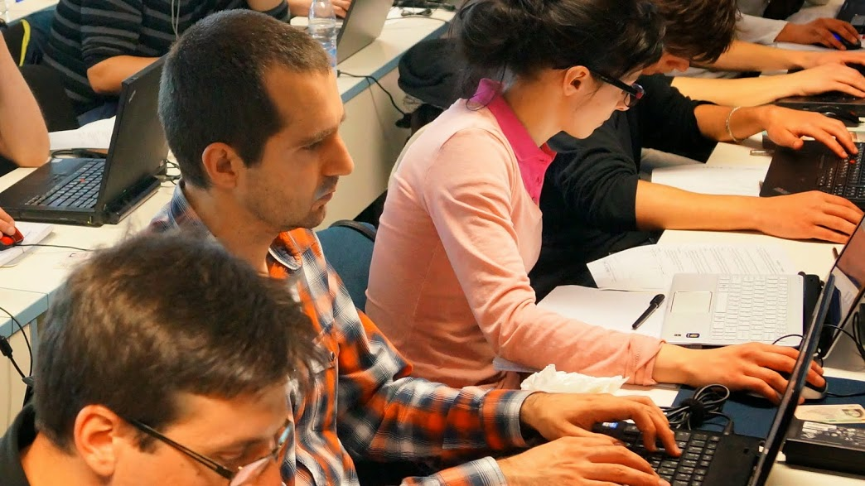

Course Program
Course Intro
Start Your Own Blog
Internet Communication Skills
Source Control Systems: Git, SVN, TFS
Project Tracking Tools: Trello, Asana, BaseCamp, …
Mind Mapping
Speed Reading and Efficient Study Techniques

Slide 11
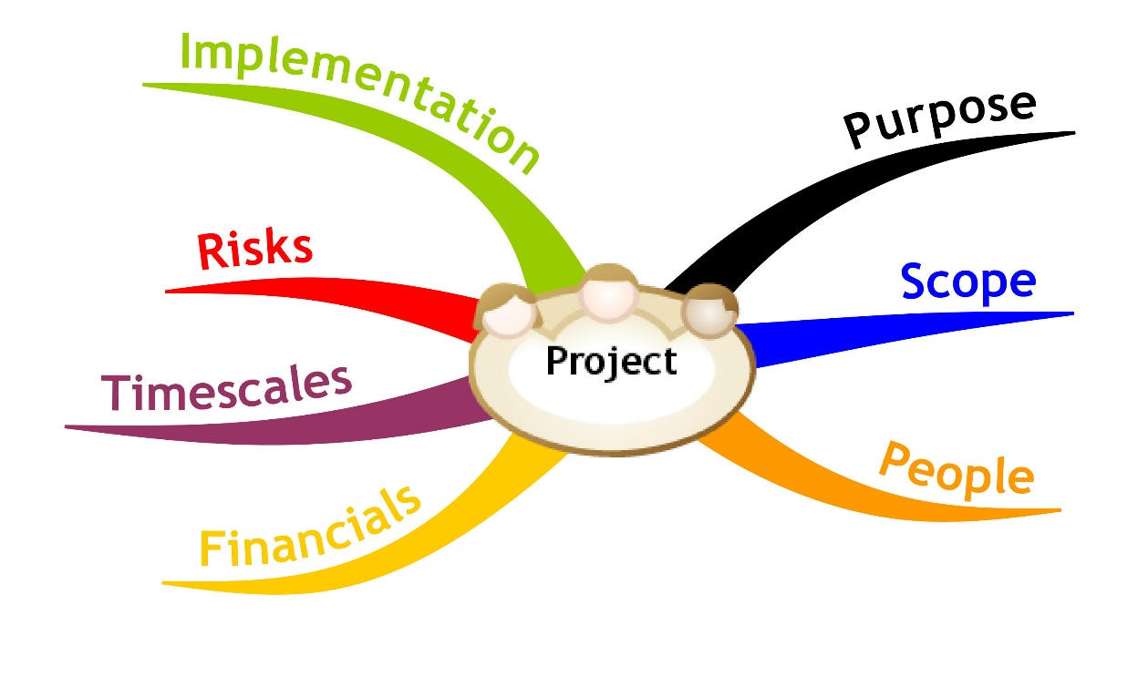
Team Work Projects @ SoftUni
Application Process, Team Work Process, Examples

Slide 12

Team Work Projects: The Process
The process for working on the team projects:
Students sign-up for a team work
The system splits the students in teams
The trainers assign a team work project
The students find each other and begin work
Students work on their projects
Assign tasks, collaborate, communicate, perform meetings, write code and documents, merge the results, etc.
Perform a public defense (presentation)
Asses each team member and give feedback

Slide 13

Sample Team Work Projects
Write a Wikipedia article about programming
E.g. "sorting algorithms", "GitHub", "C#"
Write a console-based game
E.g. Snake / Tetris / Minesweeper / Falling Rocks
Create a web site
E.g. a site for fun stories / fun images
Create a JavaScript web-based game
E.g. Tetris / Falling Rocks / Xonix

Slide 14

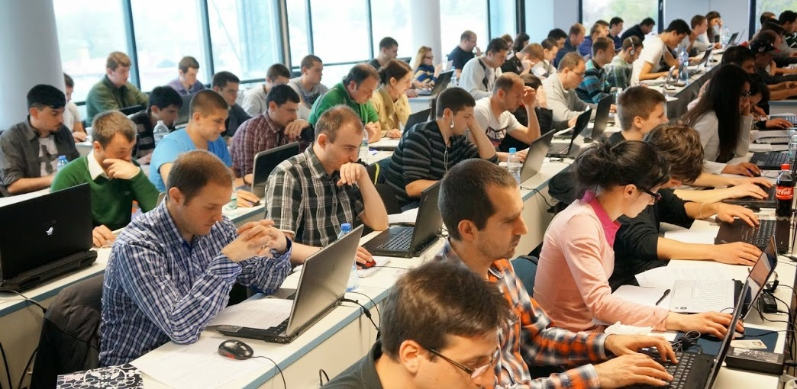

Assessment
Assessment Criteria

Slide 15


Assessment
Homework – 100%
Students submitted all homework assignments will pass the course
Bonuses (eventually)

Slide 16








Resources
What We Need in Addition to This Course Content?

Slide 17
Course Web Site & Forums
Register for the "SoftUni Forum":
Discuss the course exercises with your colleagues
Find solutions and assistance for the exercises
Share source work / discuss ideas
The course official web site:
https://softuni.bg/forum/
https://softuni.bg/courses/teamwork-and-personal-skills/

Slide 18


Books
Buzan Study Skills Handbook: The Shortcut to Success in Your Studies with Mind Mapping, Speed Reading and Winning Memory Techniques
by Tony Buzan, Pearson Education, 2007 ISBN 978-1-4066-1207-3
Как да уча бързо и да запомням лесно?
Тони Бюзан, Софтпрес, 2011 ISBN 978-954-685-837-5

Slide 19
Team Work and Personal Skills – Course Introduction
https://softuni.bg/courses/teamwork-and-personal-skills/

Slide 20
License
This course (slides, examples, demos, videos, homework, etc.) is licensed under the "Creative Commons Attribution-NonCommercial-ShareAlike 4.0 International" license
Attribution: this work may contain portions from
"Knowledge Sharing and Team Working" course by Telerik Academy under CC-BY-NC-SA license

Slide 21





Free Trainings @ Software University
Software University Foundation – softuni.org
Software University – High-Quality Education, Profession and Job for Software Developers
softuni.bg
Software University @ Facebook
facebook.com/SoftwareUniversity
Software University @ YouTube
youtube.com/SoftwareUniversity
Software University Forums – forum.softuni.bg

